Slide 1

Tata Steel: Analytics Roadmap for TISCON
02/08/2016
The information contained in the document is proprietary to Tata Industries Limited- Tata Insights & Quants Division and is strictly confidential. In consideration of receipt of this document, the recipient agrees that the information is being shared only for the limited purpose. The recipient of this information further agrees to maintain such information in confidence and to not reproduce, disclose, duplicate, electronically transmit or use in whole or in part for any other purpose. Prior written consent shall be obtained from the Insights & Quants Division of Tata Industries in case the information is necessitated to be shared with anyone other than the Recipient to whom this information is addressed. The above restriction shall not limit the right to use the information contained in this deck, if it is obtained from another source without restriction. © Copyright, Tata Insights & Quants Division, Tata Industries Limited

Slide 2
Analytics Landscape
for Tata Steel – an initial view

Slide 3
Brainstorm on Possible Pilot Projects
Initial discussions initiated
Visualization, Drill Down and Business Analysis
Predictive Analytics & Machine Learning
Optimization Simulation & Prescriptive Analytics
Ideation from Tata iQ
Customer Engagement – B2B and B2C
Top customer/repeat purchase and customer complaints dashboards
Segment wise customer value dashboard
Customer engagement & survey analysis for Wires division – B2C
Data integration and integrated analytics for TISCON – B2C
Customer value analysis
Price sensitivity and margin optimization
Demand forecasting, simulation and product mix optimization
Supply Chain Management
Supply chain dashboard based on SCOR or similar frameworks
Supplier performance & risk dashboard
Warehouse & distribution dashboard
Demand forecasting
Supplier risk prediction
Lead time forecasting
Stochastic supply chain and inventory optimization
Warehouse and distribution optimization
Supply chain scenario simulation
Production & Maintenance Management
Equipment, system and unit level performance, downtime, maintenance and productivity dashboards
Steel composition and optimization of operating paremeters– LD2 (with GTO)
Long term life time prediction
Unit, system performance simulation
Optimizing preventive maintenance
Managing Supporting Functions – finance, HR & workforce planning etc.
Spend dashboard
Revenue and COGS driver dashboard
Workforce productivity, safety, scheduling
Predict spend movement
Workforce performance and productivity prediction
Spend, revenue and COGS driver sensitivity analysis and simulation
Revenue assurance analysis
Workforce scheduling and optimization
Confidential Property of Tata Industries Ltd – Tata Insights & Quants Division

Slide 4
The analytic journey in delivering business benefits
The analytic journey towards increased sophistication requires a set of diverse tools and talent to leverage the power of diverse data sources
Leveraging multiple data sources
…..to deliver insights, prediction and optimized strategies
Visualization
Visualization
Biz Analysis
Prediction
Simulation
Optimization
Tableau, D3…
R, SAS, Python, Angoss, MatLab…
Big Data Platform
Confidential Property of Tata Industries Ltd – Tata Insights & Quants Division

Slide 5





Tools will not deliver ROI unless
supported by the right people and the right data
Selection of the right tool is critical
…..but getting the right data and having the right people is more critical
Right People
Right Data
Right Methodology
Right Tool
The tool is just one piece in the journey to business impact
Confidential Property of Tata Industries Ltd – Tata Insights & Quants Division

Slide 6
Tiscon PoC

Slide 7




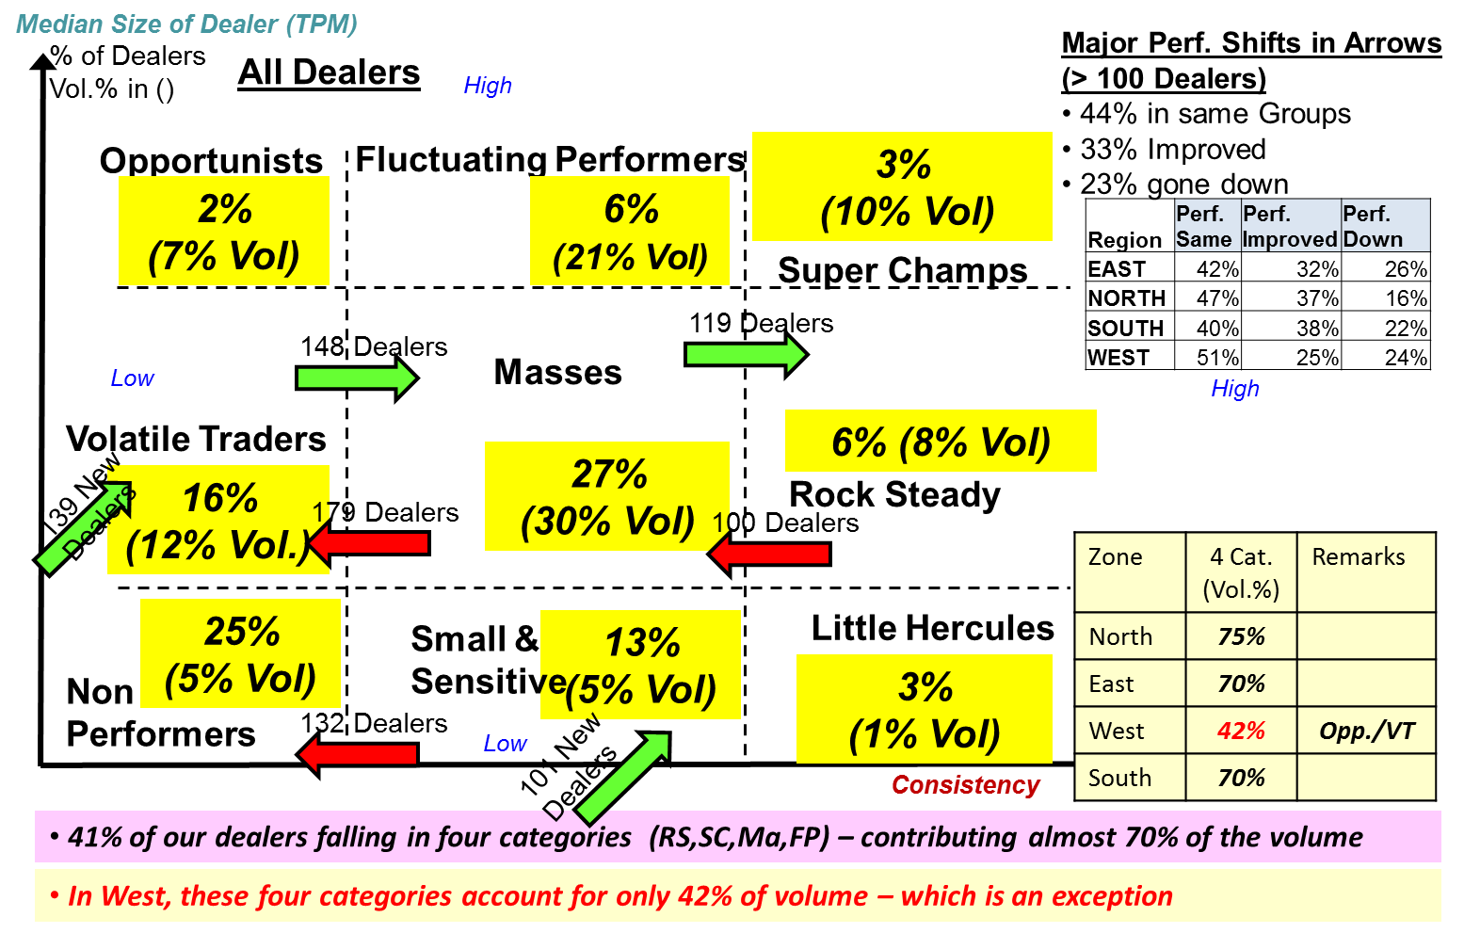









13
Tiscon – Current Landscape
DATA
REPORTING
ANALYTICS
Structured
MIS & Reports
Dealer Classification & Performance
MITR
Distributor Performance Reports – Monthly
Dealer Master Report - Daily
Sales Data
CRM, ECC
E-portal
NPS
MDMS
Unstructured
CSE Monthly MIS
Customer Meets
Call Centers
Chat Queries
Voice Data
Mail interactions
posts
OBJECTIVE : DATA INTEGRATION
Integrate data across structured & unstructured sources
Obtain a 360 view of the customer
Data Architecture for an integrated analytics ready data mart.
OBJECTIVE : VISUALIZATION
Create visualizations for existing and integrated data sources
PoC showcases interactive dashboards at a district, distributor & dealer level
Leveraging existing BO/BI tools
OBJECTIVE : PREDICTIVE ANALYTICS
Advanced Dealer segmentation
Sales Prediction Models
Dealer Attrition Prediction Models
Text mining of call log data
Market Media Mix Models for campaign effectiveness

Slide 8
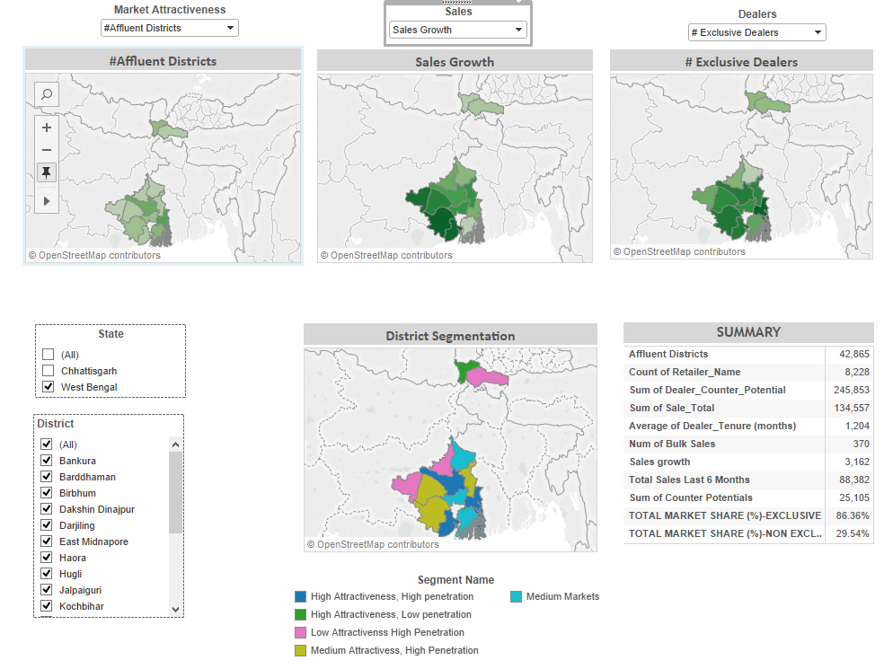
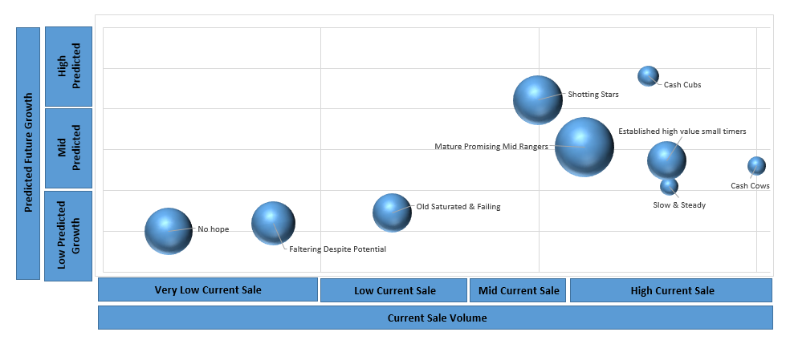

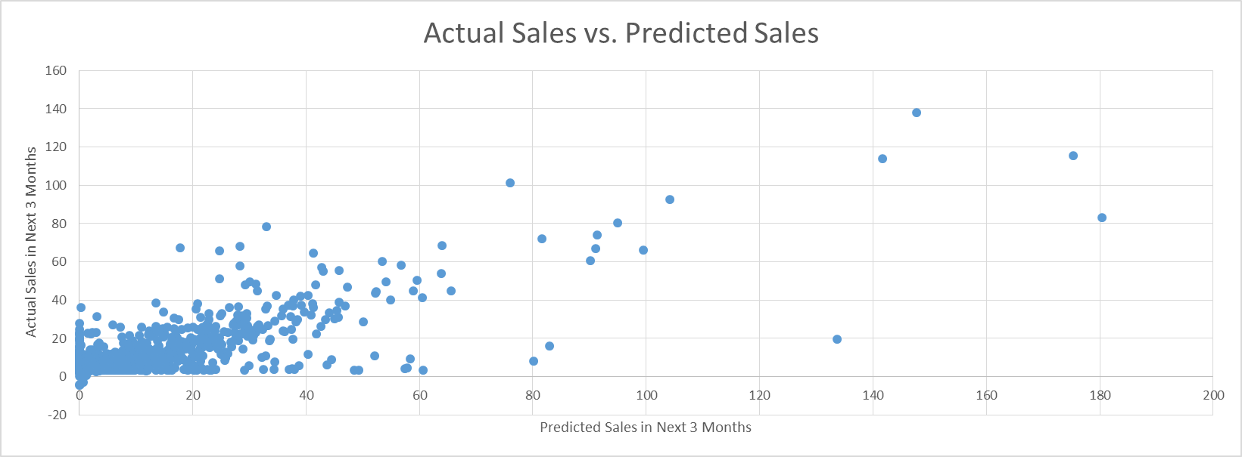

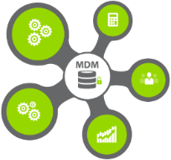
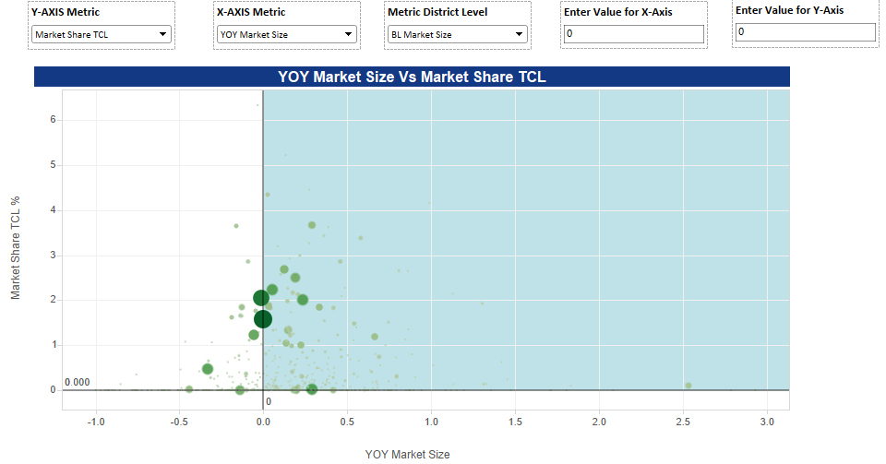
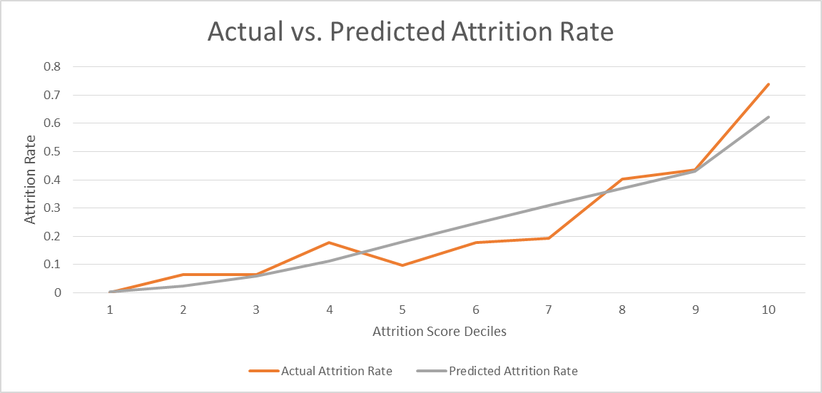




14
Tiscon – Proof of Concept
DATA
REPORTING
ANALYTICS
Roadmap for Data Management
Directional Dimensional Model for DWH
Advanced Visualization for D2R and R2C Data
Interactive Sample Dashboards & Drill Down
Dealer potential assessment
Dealer Segmentation
Sales & Attrition Prediction Models
I . Structured
Operational
II. Semi-Structured
Interactional
Dashboards in Tableau
Segmentation & Prediction
Ask Expert Website
CSI Score
Sales Data
Stock Data
MITR
CRM Data
MDMS
NPS
Integrated DWH + MDM
III. Unstructured
Customer Meets
Call Centers
Chat Queries
Voice Data
Mail interactions
posts

Slide 9
14
Tiscon – key insights
Building Blocks
Advanced visualization & drill down
Dealer potential assessment using Tata iQ data
Segmentation using unsupervised learning
Sales Prediction, Attrition Prediction, Market Mix Models
The lay of the land
2% of the retailers contribute 16% of volumes and are established super performers. A further 11% show high performance (~30% of sales)
20% of the retailers hold tremendous promise for the future
13% of retailers are performing poorly even though they belong to extremely attractive territories
16% of retailers are performing poorly and are also part of the least attractive territories
Dealer performance
High variation in sales over time seems to contribute negatively to future performance
Similarly dealers with low stocking level (or who do not update stocks in the system) prove to be laggards
High incidence of bulk sales is a very strong indicator of future performance
12% of future top performers also demonstrate higher risk of attrition (~24%)
Impact of marketing action
Consumer initiative campaigns drive the maximum impact
Customer feedback mining
Most consumers complain about dealer behaviour and not higher price or quality
42% have stated immediate buying intentions (within one week)
Insights and possible strategic interventions
Limitation & Further Analysis
Extensive territory potential assessment across the country and demand forecasting (similar to Tata iQ engagement with Tata Steel wires division)
Deeper dive and incorporation of business inputs
More extensive segmentation and predictive models covering a wider sample
Wider and broader sample for extensive market mix modelling

Slide 10
TISCON POC-
Visualization Snapshot

Slide 11
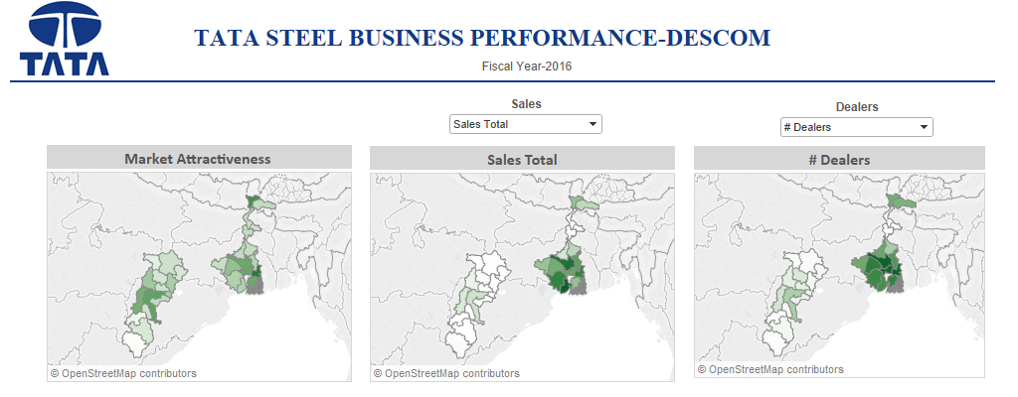
Dashboard View 1

Slide 12
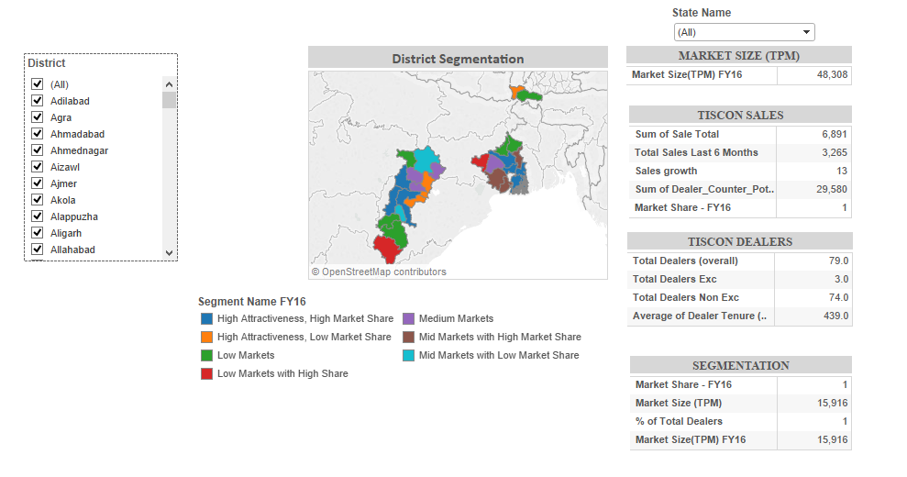
Dashboard View 1

Slide 13
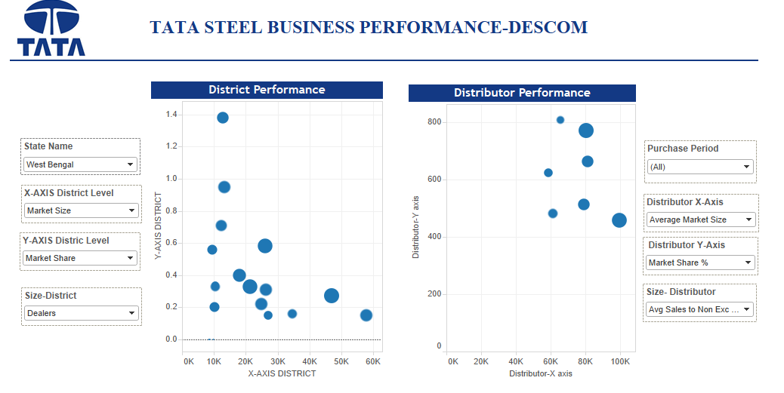
Dashboard View 2

Slide 14
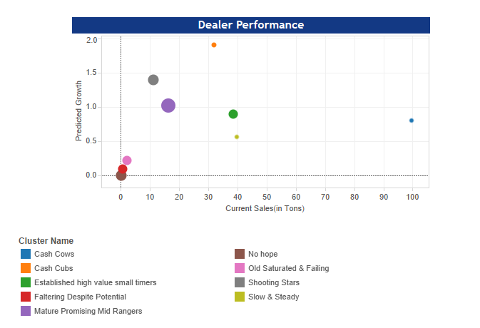
Dashboard View 2

Slide 15
TISCON POC-
Predictive Analytics

Slide 16
Retailer Sales Prediction
Linear Regression Model predicting average sales of retailers in the next 3 months
MODEL DESIGN
Dependent Variable: Avg. Sales in the next 3 months
Independent Variables: 50+ variables generated based on R2C data over the previous 12 months and dealer static information (from Dealer List)
Data details:
States: West Bengal & Chhattisgarh
Files: R2C Data (Apr’15 to Jun’16)
Exclusions:
Retailers which do not have a match with Dealer List (based on Name only)
Retailers which have been with TISCON for < 3 months
MODEL RESULTS
Model R-square: ~60%

Slide 17
Retailer Attrition Prediction
Logistic Regression Model predicting probability of retailer attrition in the next 3 months
MODEL DESIGN
Dependent Variable: Attritor Flag
An attritor is defined as a retailer whose avg. monthly sales is < 2 Tonnes
Independent Variables: 50+ variables generated based on R2C data over the previous 12 months and dealer static information (from Dealer List)
Data Used:
States: West Bengal & Chhattisgarh
Files: R2C Data (Apr’15 to Jun’16)
Exclusions:
Retailers which do not have a match with Dealer List (based on Name only)
Retailers which have been with TISCON for < 3 months
Retailers whose Avg. Monthly Sales in the last 6 months <= 0
MODEL RESULTS
Model Gini Co-efficient: ~62%

Slide 18
Marketing Mix Model
Panel Regression Model evaluating impact of marketing campaign on sales (of distributors)
MODEL DESIGN
Objective is to understand the relative impact of various marketing campaigns (cost + coverage) on sales
Dependent Variable: Log of Monthly Sales at different monthly snapshots
Independent Variables: Total cost incurred and corresponding coverage of marketing campaigns at different monthly snapshots
Data Used:
States: West Bengal
Files: Marketing Campaign Data + D2R data (Apr’15 to Mar’16)
MODEL RESULTS
Model R-square: ~30%
Results indicate that the Consumer Initiatives campaign group is the most effective form of campaign.
Following are the various campaign types within this campaign group: Ask Expert Camp, Joy Home Meet, Mega Consumer Meet, Wall Painting, Gifts for Joy Home, etc.
The impact of such a campaign on sales is most apparent after a period of 3 months

Slide 19
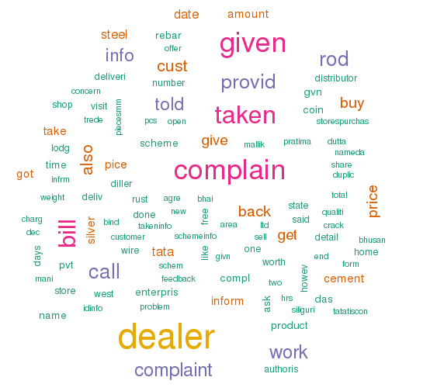
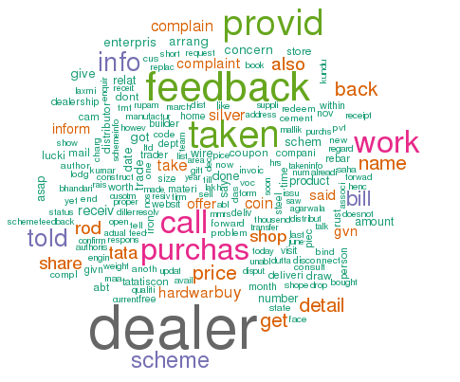
Voice of Customer
Word Clouds based on Complaints & Feedback of customers (in West Bengal)
Complaints Word Cloud
Feedback Word Cloud

Slide 20
Voice of Customer – Product Requests
Following is a summary of goods requested made by customers calling in.

Slide 21
Data Integration
&
Management

Slide 22






25
From Data to Action
The journey from Data to Action plays a key role in ‘Knowledge’ component of infrastructure as displayed below.
Data
Phase 1
Knowledge
Action
Data cleansing and integration are the key essentials towards analytical competence
Mining and forecasting trends is the key to cull out insights from the data lake
Customer centric marketing is the next step to drive data monetisation
Data Ingestion
Transform
Data Warehouse
Analyse
Predict
Visualise
Campaign
Feedback
Social
T1
T4
Linking
Quality
T2
T3
Source Systems
ETL
Database
Data Mining
Reports
CRM
Survey
Media
Oracle
R miner
SAS
Tableau
Unica
Siebel
Adobe
Informatica, Talend,
Mastercraft
Infrastructure : Servers , Network, Access
Notes:
Data , Knowledge and Action model; Bring the infrastructure layer down and on top of that put MDM, ETL etc
Shading of Data Knowledge , Action.. in shades on blue.
Put a box around the 2nd layer where we have sub components below data, knowledge & Analyse.
Data igestion – the squares should be cylinder.
Data transform : In the text put – linking, quality. The cylinder should be replaced with a square ( cylinder is only used for databases).
Remove data quality as we have combined with data transform.
The text under Data for 3rd layer:
Data ingestion : Source systems
Transform : ETL tools ( Mastercraft, informatica, abinitio)
Datawarehouse : Database ( Oracle, SAP, Teradata)
The 3 visuals under Knowledge will be : Analyze, Predict, Visulaize
Text for 2nd & 3rd layer :
Data Mining, Predict : R, SAS , SQL
Visualize : BI : Tableau, Qlickview

Slide 23
Data Warehousing Applications
Data warehousing helps in better decision support making by enabling powerful analytics
Business Intelligence
Data Modelling
Slicing and Dicing
Data Sources Consolidation
Ad-Hoc Analyses
Reports, dashboards and Insights are driven by data warehouse
Slice and Dicing of data using Drill-downs, Aggregations and cross dimensional analysis
Varied source types and segregated sources are brought together to provide holistic view of data
DWH enables creation and validation of models for analytics
Data warehouse makes data queryable for quick ad-hoc analyses
An Enterprise Data warehouse enables data driven decisions by making data usable for analytics

Slide 24

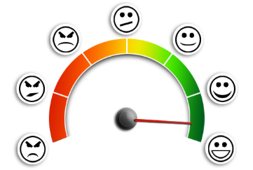
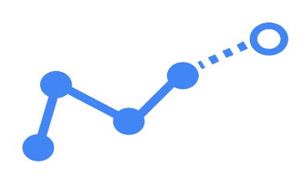
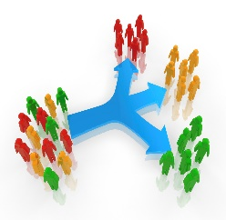




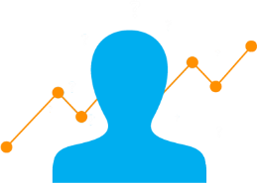

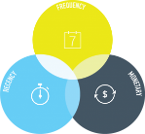
Master Data Management
MDM provides 360º view of end customer across various channels enabling powerful analytics applications
3
Sentiment Analysis
1
Siddhartha Kumar Verma | Bellandur, Bangalore | 8765432189
Siddhartha K Verma | Bellandur, Bangalore
CRM
Prediction Analytics
Sid Kumar Verma | Bangalore | 8765432189
Call log
Unique Cust ID
Customer Location
Customer History
Product
Customer Segmentation
Churn prediction
Unique Customer View - ASSERTED
2
Social Data
Transaction Data
Chat Scripts
Clickstream
Insights & Visualization
RFM Analysis
Product Reviews
Transaction pattern
Product Enquiries
Complaints
Customer behavioral pattern - DERIVED
360º view of customer profile - OBSERVED

Slide 25


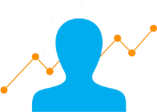

TISCON Data Sources
Phase wise distribution of data sources’ absorption in Enterprise DWH
Phase I - Structured Operational Data
Sales Sources
Descriptive Sources
Campaign Sources
Inventory Sources
R2C sales
D2R sales
Dealer Details
Distributor Details
Distributor Campaigns
Brand Health (AC Nielson)
TOC - Distributor Stock
Dealer
Stock
MITR
T2D sales
DPR report
Mason Details
Consumer Details from e-portal
Phase II – Semi - Structured Interactional Data
Phase III – Unstructured Social Data
MITR
CSI Score
Distributor feedback
Mitr meet queries
Product page
Consumer chat queries
TSL call center
Customer visits
Ask Expert Camp
Ask Expert Website
Dealer – customer interaction
Social Media posts
Customer meets
NPS
Feedback page

Slide 26
TISCON Data Entities
Major entities identified for the Enterprise data warehouse for TISCON
Dimensions
Company
Facts
Campaign
Inventory
Distributor
Product
Transactions
Entities
Actors
Sales
Dealer
Region
Customer
Fact provides metric or measurements about a business event (e.g. price)
Time
Dimensions provides descriptive reference information (e.g. Customer Name) about a measurable event (e.g. Transaction)
We have chosen Star Schema over 3NF form of data modelling because our application layer will demand heavy joins and faster query results. Star Schema is optimized for such applications

Slide 27
TISCON Dimensional Model
A sample dimensional model for the first phase of the data warehouse

Slide 28
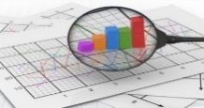
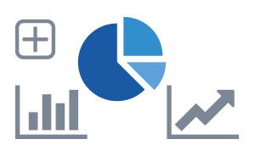


Data Management Roadmap
Phase wise plan of data management roadmap for Tata steel
Structured Data
ETL Processing
Enterprise DWH
Data Abstraction Layer
Descriptive Analytics
Transactional Data
Operational Data mart
Operational Reports
D2R sales
T2D sales
Give me sales report of last month?
R2C sales
DPR report
Interaction Data mart
Operational Dashboard
Which all are my top performing dealers?
Semi- Structured Data
Acquired Metrics
Advanced Visualization
In which district should I establish my next dealer?
Chat service
Social data
MDM
Actual data
What is the consumer sentiment about the product?
Feedback page
E-portal
Hadoop
Predictive Analytics
Unstructured Data
Social Data
What are the top complaints in the product reviews?
Futuristic

Slide 29
TISCON
Engagement Roadmap

Slide 30







15
Tiscon Engagement Roadmap
Engagement Manager
Blended FTE
Over & above
Data engineer
Data scientist
Visualization designer
Senior data scientist and data engineer as analytic reviewer
Team Composition
Project Manager
ENGAGEMENT MODEL
Dedicated Team
Joint Development with Tata Steel team
Co-Creation of Solution
Knowledge Transition
Tata Steel Capability Development

Slide 31
Appendix:
Why is Tableau a tool of choice for visualization?
Confidential Property of Tata Industries Ltd – Tata Insights & Quants Division

Slide 32
24
Why Visualize ?
Visualization is any technique of creating images, diagrams, or animations to communicate a message and it has been an effective way to communicate both abstract and concrete ideas.
2015 | Delhi |  | Mumbai |  | Bangalore
Month | Price | Sales | Price | Sales | Price | Sales
Jan | 10.0 | 8.04 | 8.0 | 6.58 | 10 | 9.14
Feb | 8.0 | 6.95 | 8.0 | 5.76 | 8 | 8.14
Mar | 13.0 | 7.58 | 8.0 | 7.71 | 13 | 8.74
Apr | 9.0 | 8.81 | 8.0 | 8.84 | 9 | 8.77
May | 11.0 | 8.33 | 8.0 | 8.47 | 11 | 9.26
Jun | 14.0 | 9.96 | 8.0 | 7.04 | 14 | 8.1
Jul | 6.0 | 7.24 | 8.0 | 5.25 | 6 | 6.13
Aug | 4.0 | 4.26 | 19.0 | 12.5 | 4 | 3.1
Sep | 12.0 | 10.8 | 8.0 | 5.56 | 12 | 9.13
Oct | 7.0 | 4.82 | 8.0 | 7.91 | 7 | 7.26
Nov | 5.0 | 5.68 | 8.0 | 6.89 | 5 | 4.74
Average | 9 | 7.50 | 9 | 7.50 | 9 | 7.5
Variance | 10 | 3.75 | 10 | 3.75 | 10 | 3.75
Visualization helps to:
Analyze : Visual Comprehension is much faster than reading
Discover : Interactive visualizations lead to information discovery
Tell a Story : Great speaker use Visuals to make memorable story
Note : Average price & Variance is the same.

Slide 33





Data Discovery Horse Track
Real data discovery requires an interactive, visual data discovery tool that makes it easy to explore and communicate data.
Question
Gathering data
Structured Data
Communicating ideas
Exploring Data

Slide 34








27
Market Analysis of Visualization
Tableau has the best rating due to its advanced visualizations capabilities, but something not solving for all BI needs.
Audience | Analysts |  | Business Managers |  | CXO’s
Purpose | Operational |  |  | Executive
Data Type | Data Sheet | Report | MIS | BI Dashboard | Discovery | Visualization
MS Excel
Tool Capability
D3

Slide 35
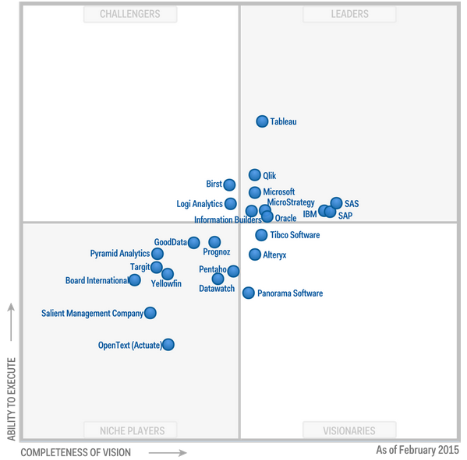
29
Why Tableau ?
Tableau is identified as optimal product in initial phase considering visual capabilities, client requirement, time to delivery and ease of use
Strengths | Cautions
Platform strength: Analytic dashboards, Free-form exploration Business-user data mash up Cloud deployment Compatibility across multiple devices Market leader - Tableau customers report among the highest scores in terms of breadth and ease of use Very good support community R&D-driven company( % revenue -29% in 2014 ) | Limited data preparation and advanced Analytics capabilities. Third-party products and partner capabilities are generally required Limited product line focused on data discovery therefore organization needs to manage more software vendors
Magic Quadrant for Business Intelligence and Analytics Platforms – Gartner 2015

Slide 36
30
Tableau Product Suite
Tableau Server is optimal choice if business user wants to empower entire organization with advanced data capabilities as it allows users to publish dashboards via browser or mobile based easily
Tableau Desktop
Self- service analytics platform for any user with a data set
Tableau Server
Business intelligence platform for organization
Tableau Online
Local Clients to view and interact with local files
Tableau Reader
Cloud-based, hosted version of Tableau Server
Tableau Server
Flexibility
User can leverage data at will, via live data connections or in memory , serving its users with speed and adaptability.
Scalability
User can roll out Tableau at department level or company-wide. It comes with both the hardware and memory to support the enterprise
Multiple Devices
Once the user produces a dashboard, he can view it anywhere, on multiple devices - with no programming capabilities required
Security
Assign security permissions at any level. The multi-tenancy features provides sites to separate both users and content

Slide 38
Data Management Solutions
The data challenges that Tata Steel faces and proposed solutions to resolve them
Tata Steel
Distributors
Dealers
End Consumers
Challenges
Siloed Sources
Limited Visualization
Limited Analytics
Static
Data
Missing 360º view of end customer
Proposed Solutions
Data Feeds
Data mart 1
Data mart 2
Enterprise Data Warehouse
Master Data Management
Applications

Slide 39
28
Comparison of Visualization tools
Tableau has the best rating due to its advanced visualizations capabilities, but something not solving for all BI needs.
Review |  | Tableau | Qlikview | Microstrategy | Oracle BI | SAP BI
Business criteria | Enterprise ready | 5 | 5 | 3 | 2 | 5
 | Usability | 5 | 5 | 4 | 2 | 5
 | Community | 5 | 4 | 2 | 2 | 2
Visualization criteria | Data interactivity | 4 | 5 | 3 | 2 | 3
 | Visual drilldown | 4 | 5 | 4 | 2 | 3
 | Dashboard support | 4 | 5 | 3 | 2 | 3
Technical criteria | Data integration | 5 | 4 | 4 | 5 | 5
 | Reporting capability | 4 | 5 | 5 | 3 | 3
Resources available | Talent and Training | 4 | 4 | 4 | 4 | 5
Analysts’ Review | Pros and cons | Easy to learn and use with large community but performance is poor with large datasets | Qlikview has the best advanced reporting capabilities but the support community is not as good as Tableau | Longest presence in the market but difficult to learn and implement | Rated at the bottom for nearly all customer user experience measures | Powerful parent company backing but visualization quality is not up to the mark
 | Final Review | Recommended | Recommended | Recommended | Not Recommended | Not Recommended
1: Poor | 2 : Average | 3 : Satisfactory | 4 : Good | 5 : Very good

